Slide 1

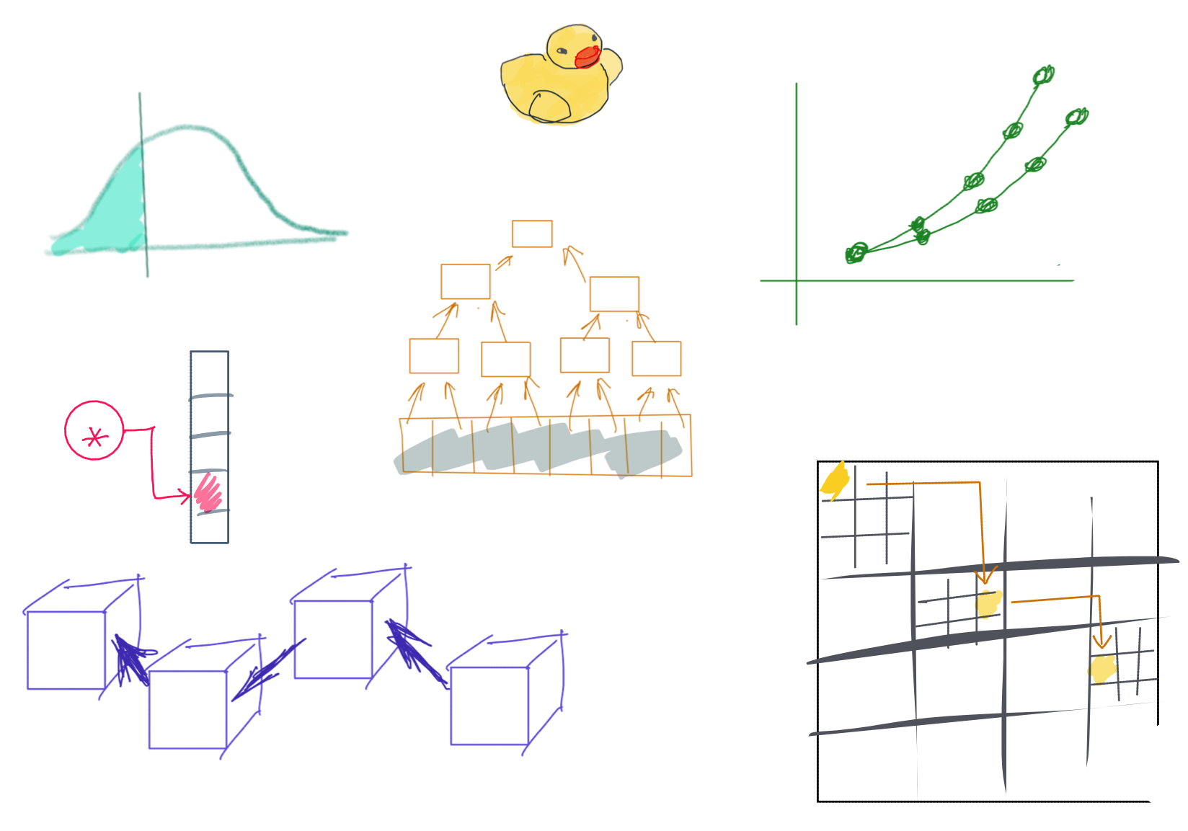

Slide 2
CSS342 Data Structures, Algorithms, and Discrete Mathematics (I)

Slide 3
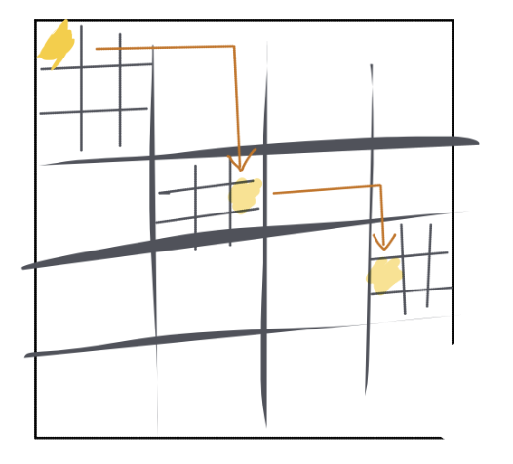
^{7th} Week Schedule
Midterm Review (Wed)
Expect grade by this Fri
Homework 3 review (Wed)
More on ADT hashtable (Wed)
Recursion (Wed & Friday)
Homework 4 to be release no later than Thursday

Slide 4
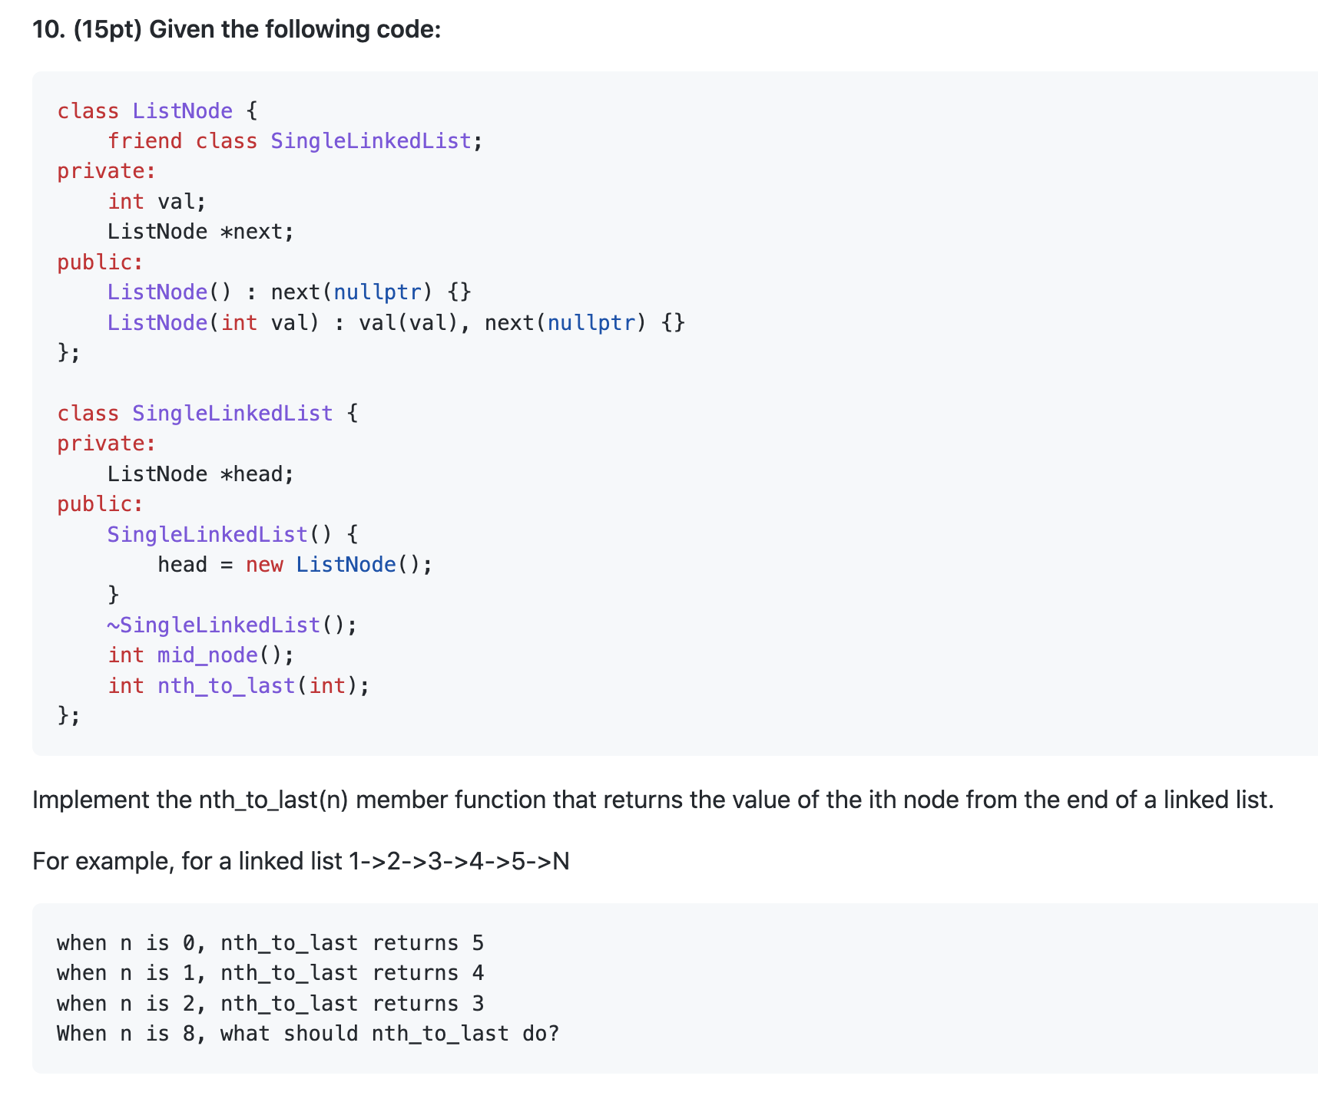
Midterm Review
The two-pointer trick
Exception

Slide 5
Midterm Review
h
1
2
3
4
n
p_slow
p_fast
n = 2

Slide 6
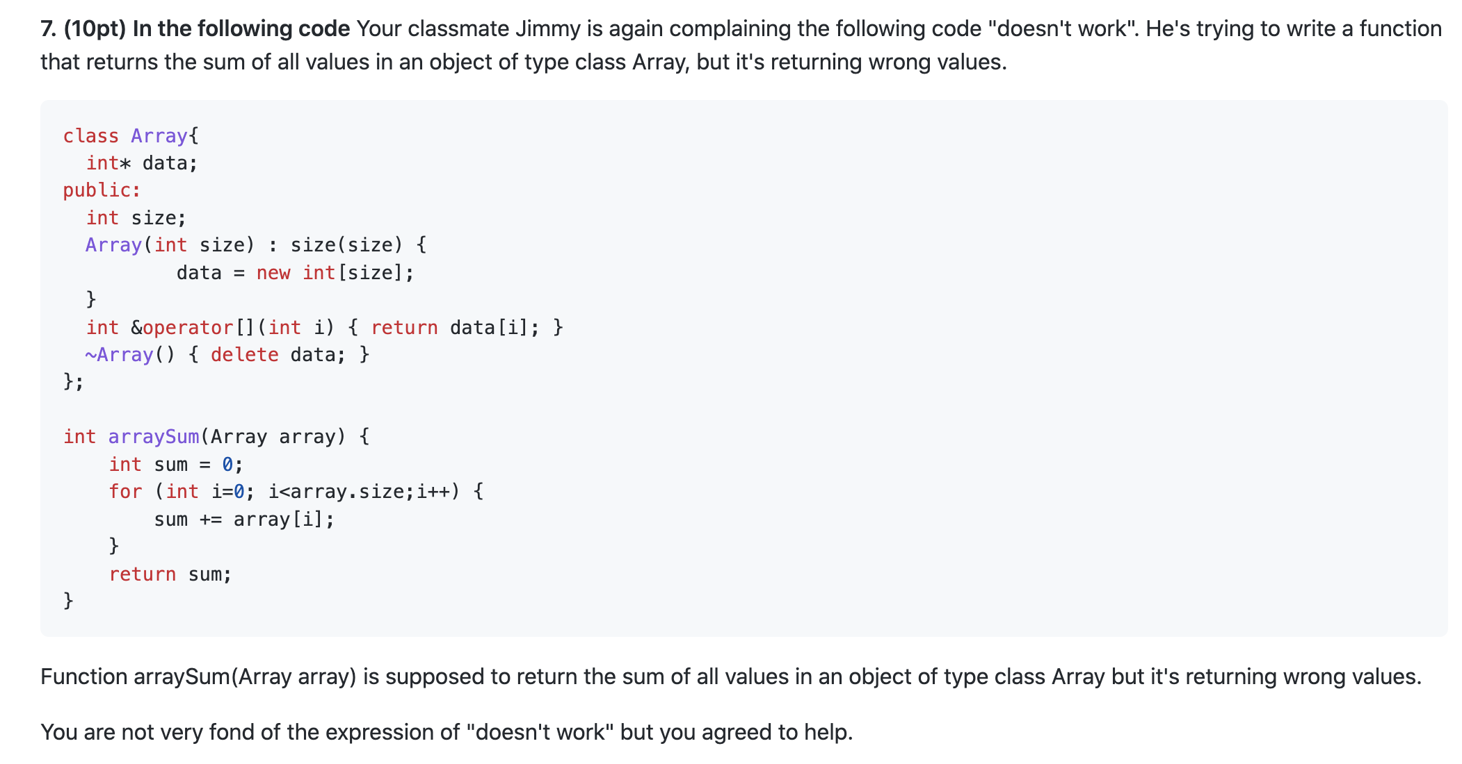
Midterm Review
Default Copy Constructor

Slide 7
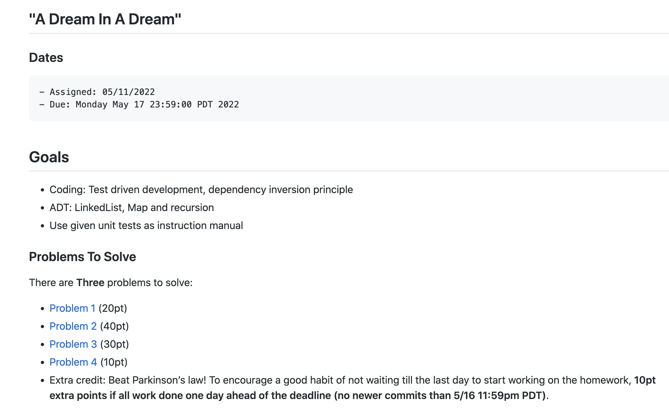
Homework 3 & 4

Slide 8
Where are we at now?
ADT (array vs list)
One-dimensional ADT
ArrayList
Stack
LinkedList
Queue
Hash table
Recursion
Search Problem
Sorting
Binary tree
multi-dimensional ADT

Slide 9
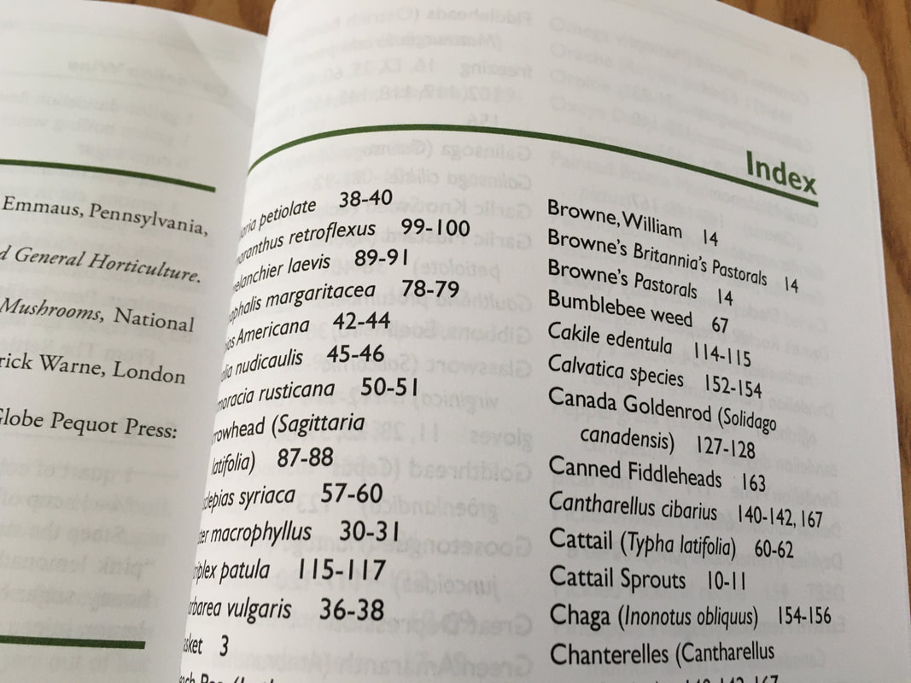
ADT HashTable
HashTable
Dictionary
Map
Set
O(1) “instant” search and insert/deletion

Slide 10
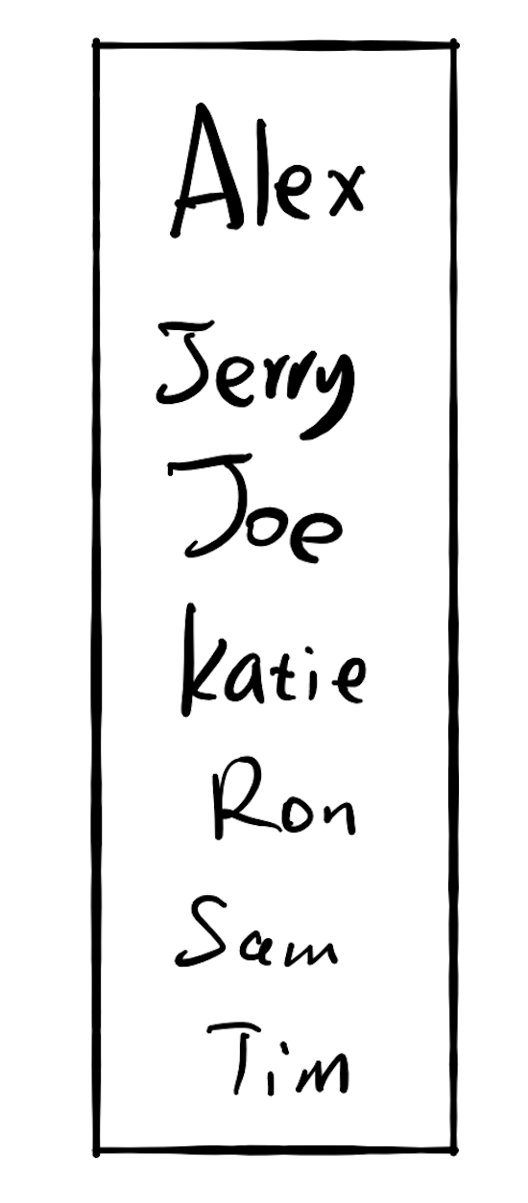
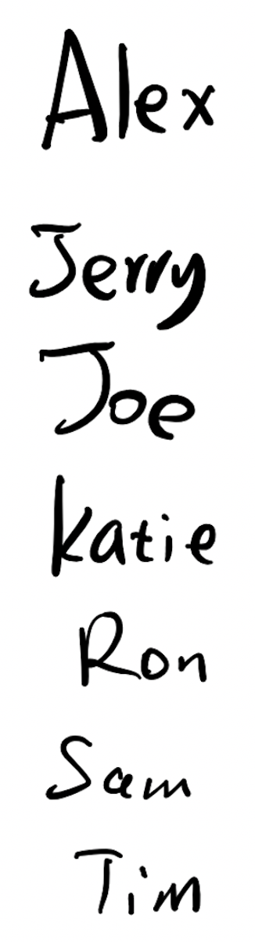
Fast for search
Slow for insertion
Slow for search
Fast for insertion

Slide 11
17.3 Do both fast?

Slide 12

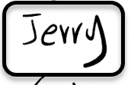
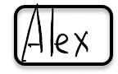


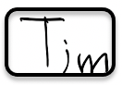



Slide 13
Hash Algorithm

Slide 14
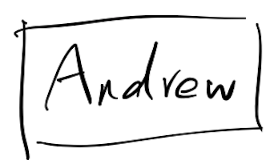
0
3
hashing
6
7
9
12
13
hashing
8

Slide 15
Key value pair: (K, V)
(K,V)
Hash function
6
Hash key
key K

Slide 16
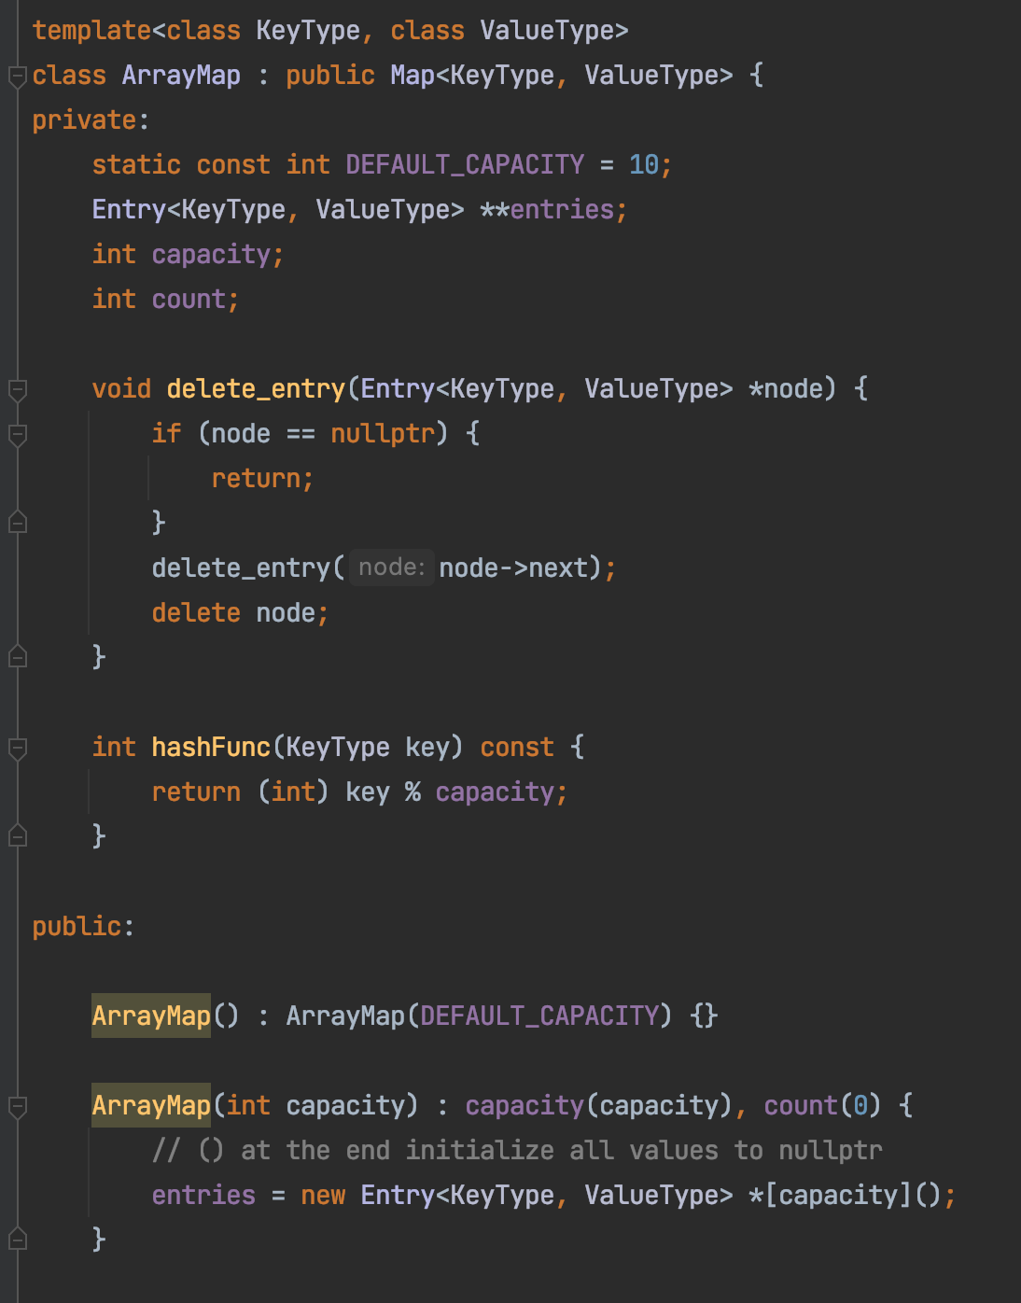
ArrayMap

Slide 17
Hashing
Key x
Index y
“Key”
“Hash Key”
String
Integer

Slide 18
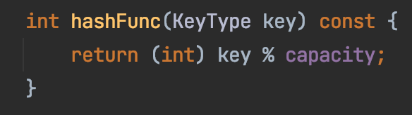
Hashing
Key x
Index y
String
Integer

Slide 19
Collision
collision
key=Sam
key=Ron

Slide 20
Collision
Three approaches
Better hashing algorithm
Find another location in the table
3. Modify the entry to be able to hold more than one set of values
https://medium.com/basecs/hashing-out-hash-functions-ea5dd8beb4dd
“open addressing”

Slide 21
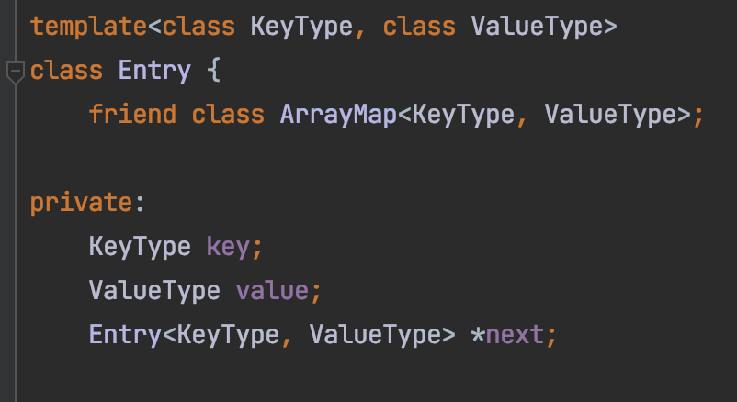
Chaining
Sam
Ron
key=Sam
key=Ron

Slide 22
Chaining
Sam
Ron
Alex
Jerry
Katie
Joe
Tim

Slide 23
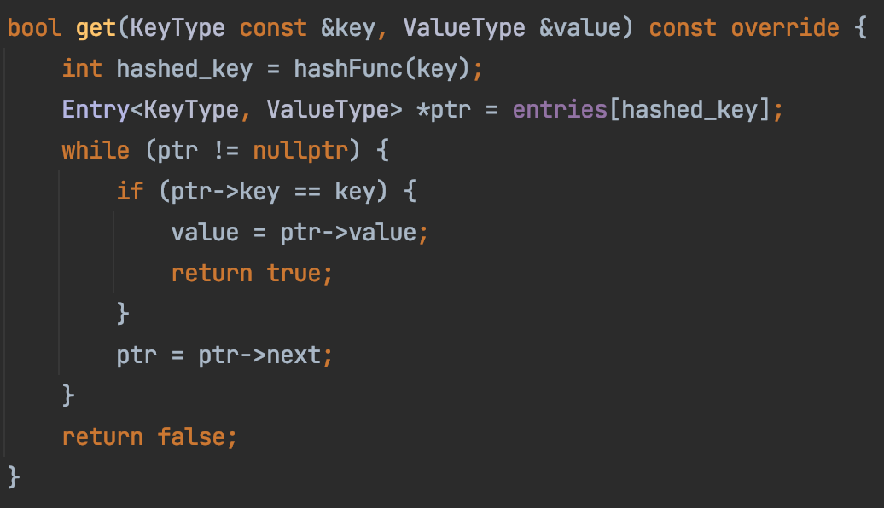
ArrayMap

Slide 24

Recursion
A function that calls itself
void callMeMaybe() {
printf(“Hello Maybe!”);
callMeMaybe();
}
Not specific to Java

Slide 25
Why Recursion?
Problem using as complex data structure
Problems of recurring nature

Slide 26

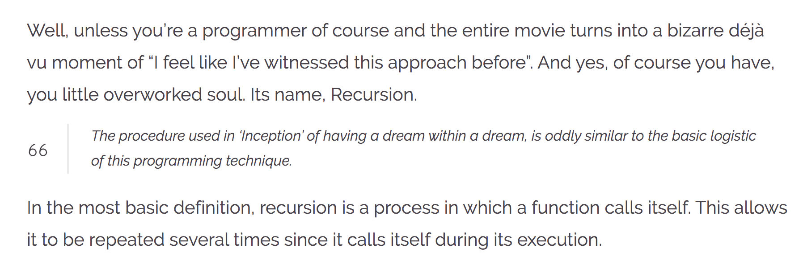
Recursion
https://wewrite.taleas.io/2018/11/14/why-inception-reminds-us-of-recursion/

Slide 27
Recursion

Slide 28
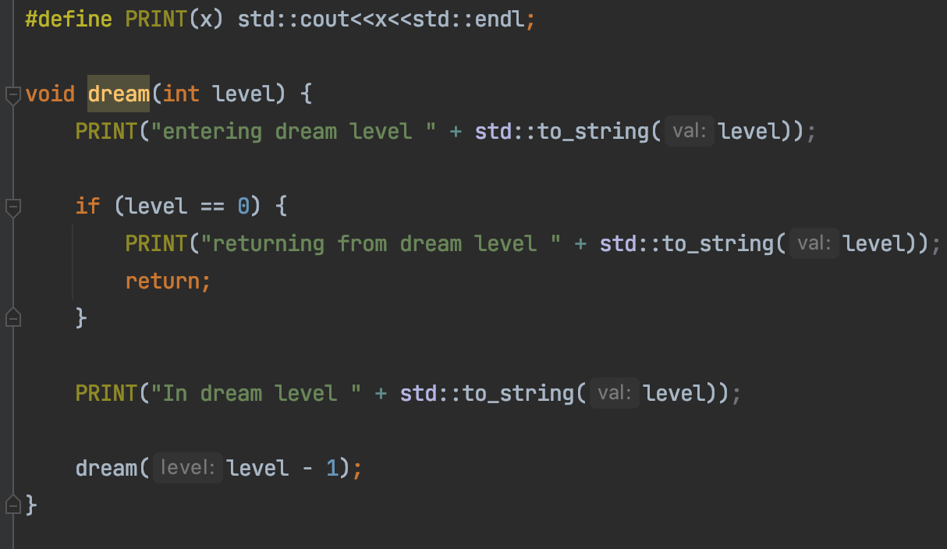
Dream in Recursion

Slide 29
Dream in Dream
Level 2
Level 1
Level 0
Time

Slide 30
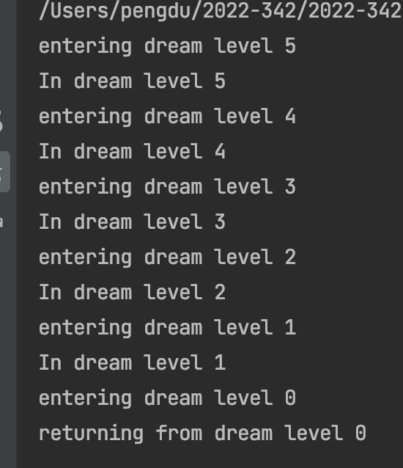
Dream in Recursion

Slide 31
Dream in Recursion
Exit condition

Slide 32
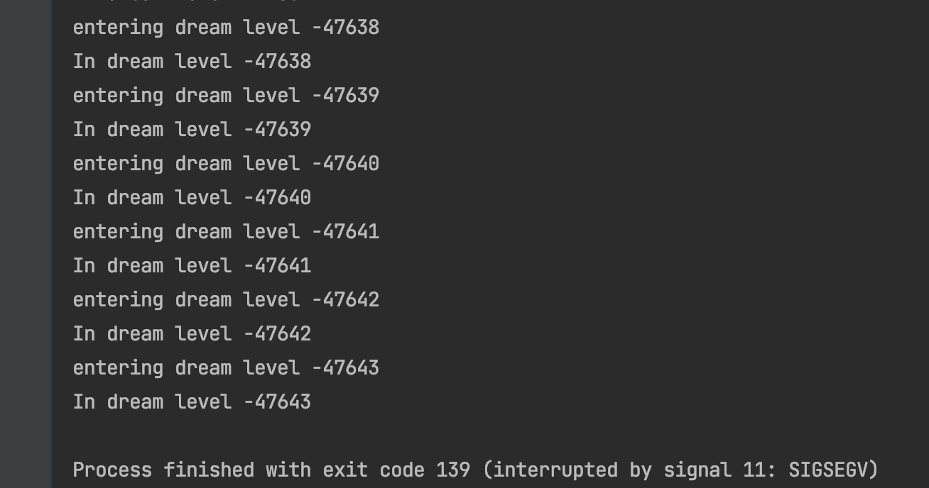
Dream in Recursion
Missing exit condition

Slide 33
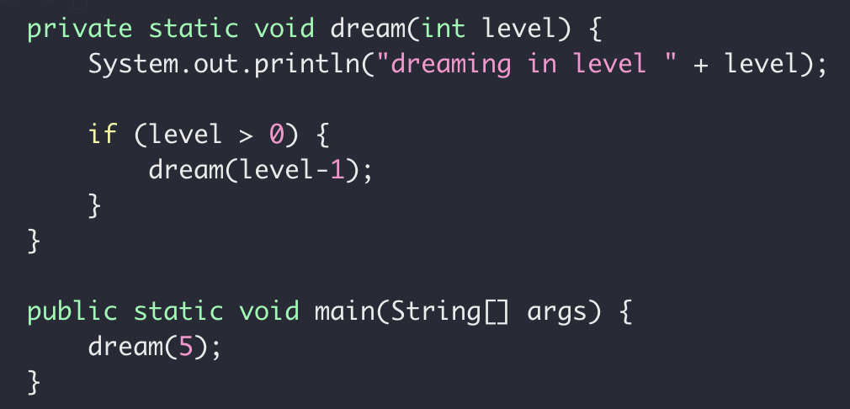
Recursion
Exit Condition
When the subproblem is ”small enough”
Stop recursion
solved directly

Slide 34
Recursion
How it works
When to use it

Slide 35
Wednesday Ends

Slide 36
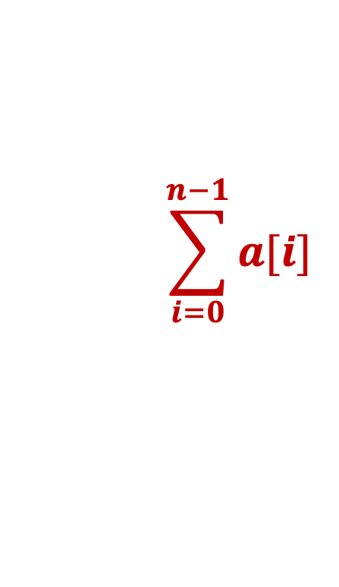
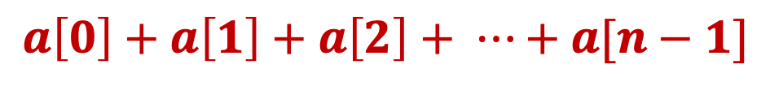
Recursive Sum
Write a function to get the sum of an integer array
$$a\left[0\right]+a\left[1\right]+a\left[2\right]+ ⋯+a[n−1]$$
$$\sum_{i=0}^{n−1}{a[i]}$$

Slide 37
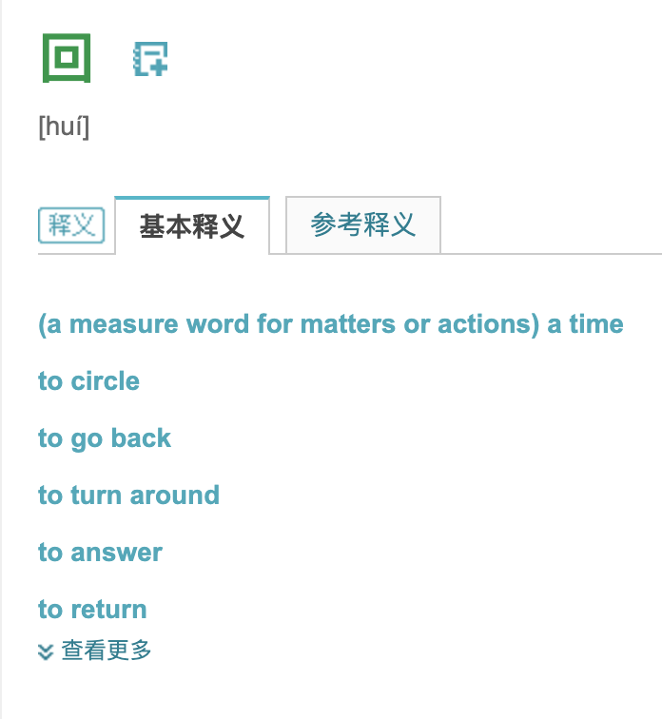
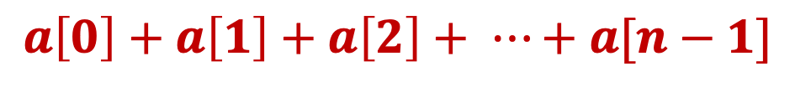
Recursive Sum
$$a\left[0\right]+a\left[1\right]+a\left[2\right]+ ⋯+a[n−1]$$

Slide 38
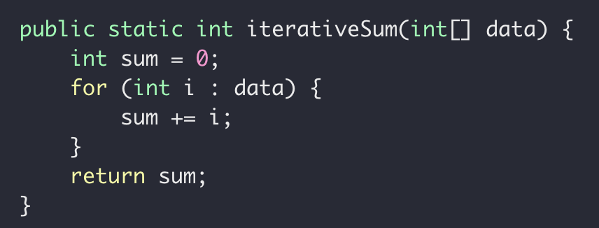
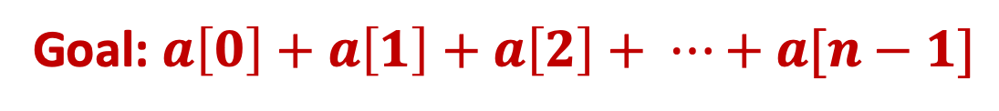
Recursive Sum
Goal: $a\left[0\right]+a\left[1\right]+a\left[2\right]+ ⋯+a[n−1]$
Iteratively

Slide 39
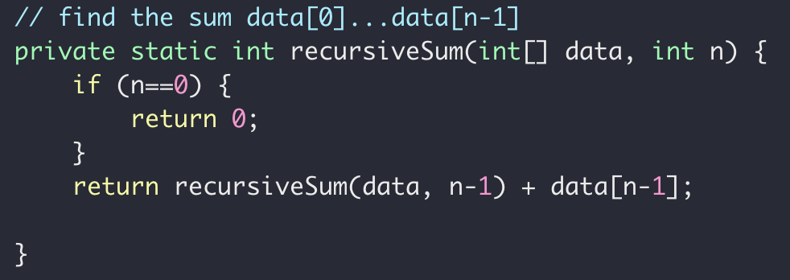
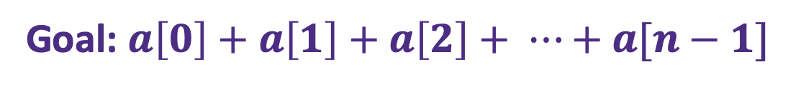
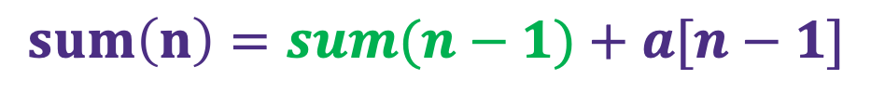

Recursive Sum
Goal: $a\left[0\right]+a\left[1\right]+a\left[2\right]+ ⋯+a[n−1]$
$sum\left(n\right)=a\left[0\right]+a\left[1\right]+ ⋯+a[n−2]+a[n−1]$
Problem
Sub-problem
$sum\left(n−1\right)=a\left[0\right]+a\left[1\right]+ ⋯+a[n−2]$
$sum\left(n−1\right)=a\left[0\right]+a\left[1\right]+ ⋯+a[n−2]$
$sum\left(n−1\right)= ?$
$sum\left(n\right)=sum(n−1)+a[n−1]$

Slide 40
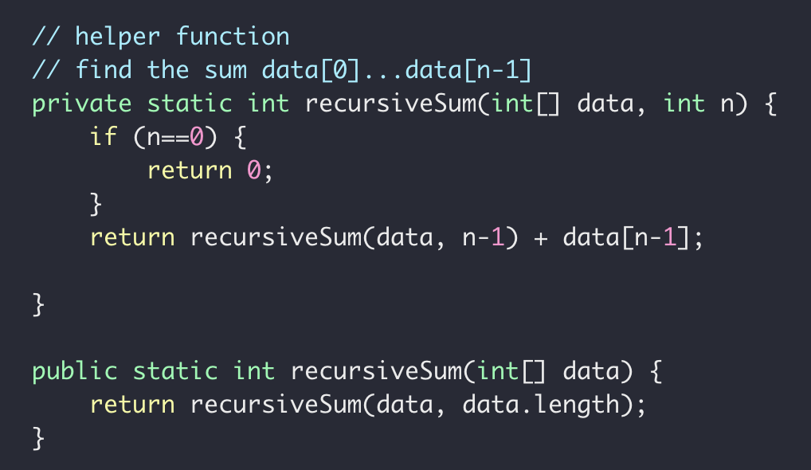
Recursive Sum
Goal: $a\left[0\right]+a\left[1\right]+a\left[2\right]+ ⋯+a[n−1]$

Slide 41

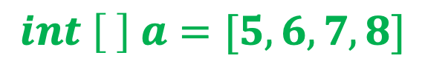
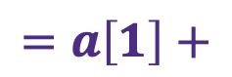

Recursive Sum
$$int \left[ \right] a=[5, 6,7,8]$$
Sum(data, 3)
Sum(data, 2)
$$=a\left[3\right]+$$
Sum(data, 1)
$$=a\left[2\right]+$$
Sum(data, 0)
$$=a\left[1\right]+$$

Slide 42
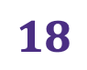

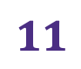


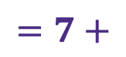
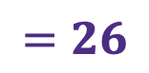
Recursive Sum
$$int \left[ \right] a=[5, 6,7,8]$$
Sum(data, 3)
$$=26$$
Sum(data, 2)
$$=8+$$
$$18$$
Sum(data, 1)
$$=7+$$
$$11$$
Sum(data, 0)
$$=6+$$
$$5$$

Slide 43
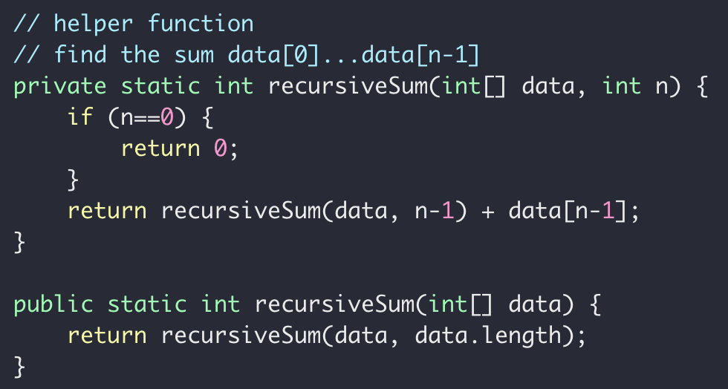
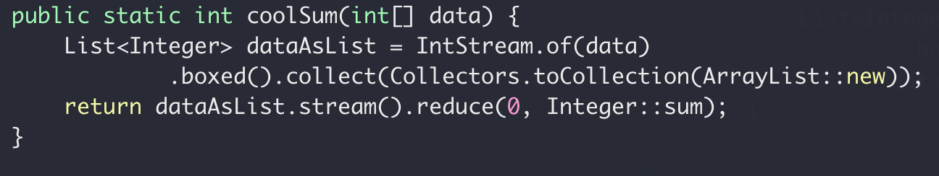
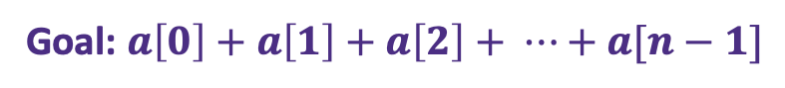
Recursive Sum
Goal: $a\left[0\right]+a\left[1\right]+a\left[2\right]+ ⋯+a[n−1]$
iterative
recursive
“modern”

Slide 44


Recursive Sum
Goal: $a\left[0\right]+a\left[1\right]+a\left[2\right]+ ⋯+a[n−1]$
Sum(data, n)
Sum(data, n-1)
$$=a\left[n−1\right]+$$
$sum\left(n\right)=a\left[n−1\right]+sum(n−1)$

